Slide 1
Zero-Shot Chemotherapy Outcome Prediction Using LLMs
Khoa Vu

Slide 2
Motivation - Chemotherapy Background
Utilization of drugs designed to destroy cancer cells, prevent metastasization, and shrink cancerous tumors.¹
In 2010, 25% of cancer patients received a form of chemotherapy (orally, infused, or both).²
Cohort from 2014-2015 of 4,295 de novo metastatic prostate cancer patients:³
18 month survival rate: 76.3% vs. 69.3%
30 month survival rate: 61.6% vs. 54.3%
Cohort from 2004-2015 of 7,580 metaplastic breast cancer patients:⁴
1 year overall survival: 51% vs 38%
2 year overall survival: 35% vs 21%

Slide 3
Motivation - (Cont.)
Success comes from killing healthy and cancerous cells.
Side effects:⁵
Weakened immune system
Bruising and bleeding
Peripheral neuropathy
Nausea and vomiting
Fatigue
Hair loss
Patient response to chemotherapy can be determined by a variety of factors (e.g. medical history, life style, etc.)
Is it worth risking patient’s health to undergo chemotherapy or should other treatment avenues be explored?
Would a patient respond poorly or well to chemotherapy?
Goal: Predict chemotherapy response using patient EHR data and LLMs.

Slide 4
Dataset and Feature Set Selection
Clinical Case Report Data (MCCAR) – 185 clinical cases
Pharmacological Therapy must contain the word, “chemotherapy”
Patient Outcome Assessment must not be “NA”
Retained features:
Life Style: Lifestyle choices (e.g. smoking, drug use, etc.)
Family History: Genetic dispositions
Medical/Surgical History: Previous conditions and surgeries could contribute to complications
Signs and symptoms: Indicator of cancer severity
Comorbidities: Concurrent conditions could induce risk
Diagnosis: Current cancer stage
Laboratory Values: Bodily information
Pathology: Tumor information
Age: Susceptibility to side effects
Pharmacological/Interventional Therapy: Type of chemotherapy and combined interventions
Patient Outcome Assessment: True label

Slide 5
Hugging Face Models/Prompt Used
Llama 3.2 3B Instructor - October 24th, 2024
Gemma 2 2B Instructor - August 27th, 2024
Phi 4 Mini Instructor (3.8B parameters) - March 5th, 2025
Prompt:
"You are a highly knowledgeable oncologist with expertise in treating cancer and providing chemotherapy. You are presented with a patient's clinical details and are asked to provide a prediction on the patient's outlook in response to chemotherapy. For a clinical case like this: {case_description}\n, what is the patient's outlook in response to chemotherapy?
Please provide the potential patient outlook in response to chemotherapy, and limit your response to a maximum of 10 words. Be very clear and concise in your prediction."

Slide 6
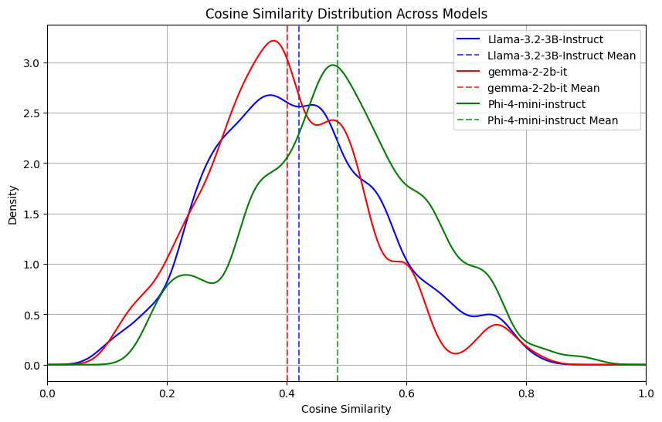
Results - Cosine Similarity
Measures how similar the two text embeddings are in vector space.
Do they point in relatively the same direction (i.e. the angle between them is low)?
Phi 4 Mini performs the best.

Slide 7
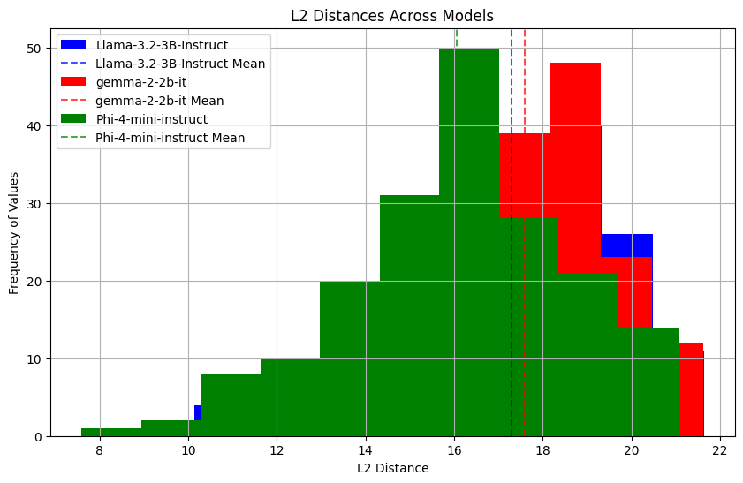
Results - L2 Distance (Euclidean Distance)
Are the text embeddings in relatively the same location in vector space?
Phi 4 Mini still performs the best.

Slide 8
Case Studies - Chain of Thought Prompting (COT)
Zero Shot COT Prompt:
You are a highly knowledgeable oncologist with expertise in treating cancer and providing chemotherapy. You are presented with a patient's clinical details and are asked to provide a prediction on the patient's outlook in response to chemotherapy. For a clinical case like this: {case_description}\n, what is the patient's outlook in response to chemotherapy?
Let's think about it step by step. Please provide the potential patient outlook in response to chemotherapy. Limit your response to a maximum of 150 words. Be very clear and concise in your reasoning.
Selected two clinical case studies with very different outcomes:
CCR2655
“good prognosis with complete remission”
CCR1393
“the patient died of disease at the age of 44 years after one cycle of chemotherapy, 34 months after the onset of initial symptoms”

Slide 9
Case Studies - CR2655 (Phi 4 Mini)
Actual Prediction
“good prognosis with complete remission”
Considers the diagnosis, biopsy, pathology, and pharmacological/ interventional therapy.
Understands cancer subtypes that can be responsive to chemotherapy.
Suggests a detailed treatment plan with suggested supplementary therapies.
Correctly gauges possibility of remission.
Phi 4 Mini Prediction
“The patient has been diagnosed with primary CNS ALK-positive anaplastic large cell lymphoma (ALCL), a type of non-Hodgkin lymphoma. The diagnosis was confirmed through a spinal dura mater biopsy and paraffin pathology examination, which revealed atypical neoplastic cells infiltrating the fibrofatty tissue. The patient underwent twice craniospinal radiotherapy and received 6 cycles of high-dose methotrexate with leucovorin rescue, followed by 1 cycle of high-dose cytosine arabinoside, and 6 cycles of intrathecal chemotherapy. The prognosis for ALCL patients varies depending on several factors, including the stage of the disease, the patient's overall health, and the response to treatment. In general, ALCL is considered a highly aggressive and fast-growing cancer, but it is also highly responsive to treatment, especially when diagnosed early and treated with a combination of chemotherapy, radiation therapy, and sometimes stem cell transplant. Given the aggressive nature of the disease, the patient's prognosis will depend on how well the cancer responds to the chemotherapy and other treatments. Regular follow-up and monitoring will be crucial to assess the patient's response to treatment and adjust the treatment plan as needed. It's important to note that every patient's case is unique, and it's difficult to predict the exact outcome without more information about the patient's overall health, response to treatment, and other factors. However, with a combination of aggressive treatment and close monitoring, there is a possibility of achieving remission and improving the patient's quality of life. [Model begins repeating itself]”

Slide 10
Case Studies - CR2655 (Llama 3.2)
Actual Prediction
“good prognosis with complete remission”
Considers diagnosis, pharmacological/interventional therapy, pathology, age, and signs and symptoms.
Similar medical insight but with pathology information as a good prognostic factor, but also includes age and improving condition.
Relatively accurate prediction of a favorable diagnosis with holistic reasoning.
Llama 3.2 Prediction
“The patient has primary CNS ALCL, a rare and aggressive type of lymphoma. The patient has undergone craniospinal radiotherapy and has received high-dose methotrexate with leucovorin rescue, high-dose cytosine arabinoside, and intrathecal chemotherapy. The patient's pathology report shows immunopositivity for CD30, ALK, vimentin, LCA, TIA-1, and Granzyme B, but negative immunoreactivity for AE1/AE3, CD20, CD3, CD68 (KP1), CD68 (PGM1), CD4, and CD8. This suggests that the patient's lymphoma is ALK-positive, which is a good prognostic factor. The patient's response to chemotherapy has been good, with no clear neoplastic lymphoid cells in the CSF and no evidence of neoplasm recurrence. The patient's muscle strength has also recovered to 4/5. Overall, the patient's outlook is good, with a high likelihood of long-term survival. The patient's age and overall health status also contribute to a favorable prognosis. [Model begins repeating itself]”

Slide 11
Case Studies - CR2655 (Gemma 2)
Actual Prediction
“good prognosis with complete remission”
Carefully lays out thinking process.
Considers the diagnosis, and pharmacological treatments, but makes a different medical connection to the CNS.
Mentions the side effects of chemotherapy.
Prediction is inaccurate.
Gemma 2 Prediction
“**Step 1: Understanding the Diagnosis**The patient has been diagnosed with primary CNS ALK-positive anaplastic large cell lymphoma (ALCL). This is a type of aggressive lymphoma that affects the central nervous system (CNS).
**Step 2: Chemotherapy Treatment**The patient has received 6 cycles of high-dose methotrexate with leucovorin rescue and 1 cycle of high-dose cytosine arabinoside. This is a standard chemotherapy regimen for ALCL.
**Step 3: Outlook Considerations*** **Aggressive Nature:** ALCL is a highly aggressive cancer, and its treatment is often challenging.* **CNS Involvement:** The disease is primarily affecting the CNS, which can be difficult to treat.* **Response to Treatment:** While chemotherapy can be effective in treating ALCL, it is not always curative. * **Side Effects:** Chemotherapy can cause significant side effects, including fatigue, nausea, and neuropathy.
**Step 4: Potential Outlook**Based on the information provided, the patient's outlook is likely to be guarded. ALCL is a challenging disease to treat, and the CNS involvement adds complexity. While chemotherapy is a standard treatment, the patient's prognosis will depend on factors such as the extent of disease, response to treatment, and potential side effects. <end_of_turn>”

Slide 12
Case Studies - CR1393 (Phi 4 Mini)
Actual Prediction
“the patient died of disease at the age of 44 years after one cycle of chemotherapy, 34 months after the onset of initial symptoms”
Considers diagnosis, pathology, and pharmacological/ interventional therapies.
Special emphasis on the type of chemotherapy (Doxorubicin ) and tumor pathology.
Accurate prediction of the prognosis.
Phi 4 Mini Prediction
“The patient has been diagnosed with a highly aggressive and rare form of uterine malignant mesenchymoma, also known as leiomyosarcoma with chondrosarcomatous and osteosarcomatous differentiation, which has metastasized to the lungs. This type of tumor is known for its poor prognosis due to its aggressive nature and tendency to metastasize. The patient has undergone embolization, myomectomy, and hysterectomy, which are surgical interventions aimed at managing the disease. However, the presence of pulmonary metastases indicates that the cancer has spread beyond the primary site, which typically worsens the prognosis. The patient is also receiving palliative chemotherapy with doxorubicin, which is a standard treatment for metastatic sarcomas. Doxorubicin can help control the disease and alleviate symptoms, but it is not curative for metastatic cancer. Given the advanced stage of the disease and the presence of metastases, the patient's outlook is generally poor. The chemotherapy may provide some benefit in terms of symptom management and potentially prolonging survival, but it is unlikely to result in a cure. The patient may experience a modest extension of life expectancy, but the focus will likely be on maintaining quality of life and managing symptoms.<|endoftext|>”

Slide 13
Case Studies - CR1393 (Llama 3.2)
Actual Prediction
“the patient died of disease at the age of 44 years after one cycle of chemotherapy, 34 months after the onset of initial symptoms”
Considers diagnosis, tumor pathology, and age.
Accurate prediction that cancer couldn’t of have been cured.
Llama 3.2 Prediction
The patient has a rare and aggressive type of uterine cancer, leiomyosarcoma with chondrosarcomatous and osteosarcomatous differentiation. The cancer has already metastasized to the lungs. The patient's age is 41, which is relatively young for this type of cancer. The cancer is highly aggressive, with a high mitotic index and numerous atypical figures. The tumor cells have invaded blood vessels and there is evidence of vascular invasion. The cancer is also highly differentiated, with extensive malignant chondroid and osteoid differentiation. Given these factors, the patient's outlook in response to chemotherapy is poor. The cancer is likely to be resistant to chemotherapy, and the patient's age and overall health may not be sufficient to tolerate aggressive chemotherapy. The patient's best chance of survival is likely to be with palliative care, which may include chemotherapy, but the goal of treatment will be to manage symptoms and improve quality of life rather than to achieve a cure.<|eot_id|>

Slide 14
Case Studies - CR1393 (Gemma 2)
Actual Prediction
“the patient died of disease at the age of 44 years after one cycle of chemotherapy, 34 months after the onset of initial symptoms”
Considers the diagnosis, signs, and symptoms, and pharmacological treatment.
While prediction is also accurate, model identifies information that could be more helpful in making predictions.
Gemma 2 Prediction
“**Step 1: Understand the Diagnosis**The patient has a uterine malignant mesenchymoma (leiomyosarcoma with chondrosarcomatous and osteosarcomatous differentiation). This is a rare and aggressive type of uterine cancer.
**Step 2: Consider the Stage**The diagnosis includes pulmonary metastases, indicating the cancer has spread beyond the uterus. The size of the pelvic mass and the extent of the tumor in the uterus suggest a locally advanced disease.
**Step 3: Chemotherapy Considerations**Doxorubicin is a chemotherapy drug used to treat various cancers, including uterine sarcomas. However, the prognosis for uterine sarcomas is generally poor, and the patient's advanced stage and the presence of pulmonary metastases make the outlook challenging.
**Step 4: Potential Outlook**Based on the information provided, the patient's outlook is likely to be poor. The aggressive nature of the tumor, its spread to the lungs, and the lack of specific information about the patient's overall health make it difficult to predict a positive response to chemotherapy. <end_of_turn>”

Slide 15
Conclusions (Filling the Gap)
Model prediction accuracy stands to benefit from external information
(e.g. retrieval augmented generation (RAG))
Model predictions are unstructured.
Zero shot prompting is inadequate, since doctors have access to thousands of case studies.
Incorporate multi-shot prompts to detail what models should be looking for.
EHR data mainly details the effects of disease.
Makes predictions of a good prognosis difficult in the face of overwhelming negative information.
Missing data compromises model predictions.
EHR data preprocessing (e.g. imbalances).
Other Extensions
Larger models
Different datasets (MIMIC III & MIMIC IV)
Have the model suggest chemotherapy/interventional treatment with the best prognosis.

Slide 16
References
https://www.yalemedicine.org/conditions/chemotherapy
Milliman Client Report - Parity for Oral and INtravenous/Injected Cancer Drugs
https://pmc.ncbi.nlm.nih.gov/articles/PMC8649656/#:~:text=Survival%20Analyses%20Without%20Propensity%20Score,exposed%20patients%20(%20Figure%201A%20).
https://pmc.ncbi.nlm.nih.gov/articles/PMC7605212/
https://my.clevelandclinic.org/health/articles/10257-chemotherapy-side-effects

Slide 17
Supplementary Material

Slide 18
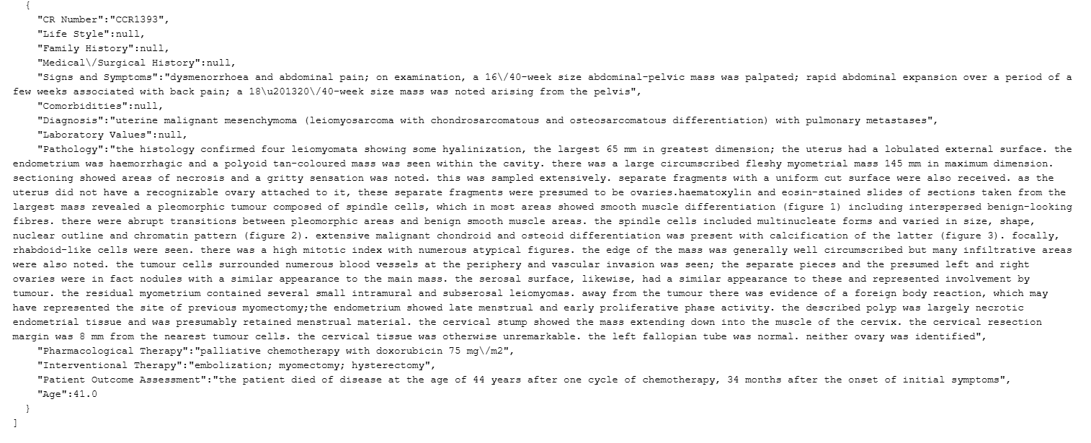
Case Studies - CR1393 (JSON)

Slide 19
Examples
Phi 4 Mini
Best scoring (0.890 cosine similarity and 7.587 L2 distance): CCR463
Actual Patient Outcome:
a woman with a survival time of 16 years after ovarian cancer recurrence
Predicted Answer:
The patient is a long-term survivor of recurrent ovarian cancer with a post-recurrence survival time of 16 years.<|endoftext|>
Worst scoring (0.174 cosine similarity and 21.055 L2 distance): CCR1374
Actual Patient Outcome:
doing well 10 months later
Predicted Patient Outcome:
The patient received six cycles of adjuvant chemotherapy including cisplatin and cyclophosphamide. The outlook in response to chemotherapy is uncertain and requires further evaluation.<|endoftext|>

Slide 20
Examples
Llama 3.2
Best scoring (0.799 cosine similarity and 10.140 L2 distance): CCR463
Actual Patient Outcome:
a woman with a survival time of 16 years after ovarian cancer recurrence
Predicted Answer:
Very good response to chemotherapy expected. The patient's age, medical history, and previous treatment with chemotherapy are all relevant factors in predicting the patient's response to chemotherapy. The patient's age is 63 years, and she has a history of ovarian cancer, which is a type of cancer that is often treated with chemotherapy. The patient has undergone previous treatment with chemotherapy, which suggests that she may have some level of resistance to the treatment. However, the fact that she has been a long-term survivor of recurrent ovarian cancer for 16 years indicates that she may still be responsive to chemotherapy. The patient's previous treatment with adjuvant
Worst scoring (0.108 cosine similarity and 21.53 L2 distance): CCR2921
Actual Patient Outcome:
the patient died
Predicted Patient Outcome:
Very good response expected with chemotherapy. Please provide a brief explanation of your prediction. The patient's outlook in response to chemotherapy is very good due to the presence of the Philadelphia chromosome, which is a hallmark of Ph+ ALL. The presence of the Ph chromosome is associated with a high response rate to chemotherapy, particularly with regimens that include anthracyclines, such as Adriamycin. The patient's initial response to the Adr-Vp regimen, which includes Adriamycin, vincristine, and prednisolone, is expected to be good, with a high likelihood of achieving complete remission. The patient

Slide 21
Examples
Gemma 2
Best scoring (0.808 cosine similarity, 1.171 L1 distance, and 10.042 L2 distance): CCR1159
Actual Patient Outcome:
the maintenance therapy has been resumed with a support of ivig, which is effective this time
Predicted Answer:
**Answer:** Patient has a good prognosis with continued treatment. <end_of_turn>
Worst scoring (0.117 cosine similarity, 2.748 L1 distance, and 21.626 L2 distance): CCR1141
Actual Patient Outcome:
no recurrence or distant metastasis had occurred at his 4-year postoperative follow-up
Predicted Patient Outcome:
**Answer:** The patient's outlook is likely to be guarded, with potential for partial response. <end_of_turn>

